Slide 1
How to Use i2b2
URL to i2b2:
https://i2b2.uthscsa.edu/webclient/
Questions?
Please contact the Clinical Informatics Research Division at informatics@uthscsa.edu

Slide 2
Table of Contents
Click the section titles to jump to that section!
Logging in
Finding the terms/concepts you are looking for
Building your query
Running your query
Accessing previous queries
Using Plugins
Advanced query building
  Temporal constraints

Slide 3
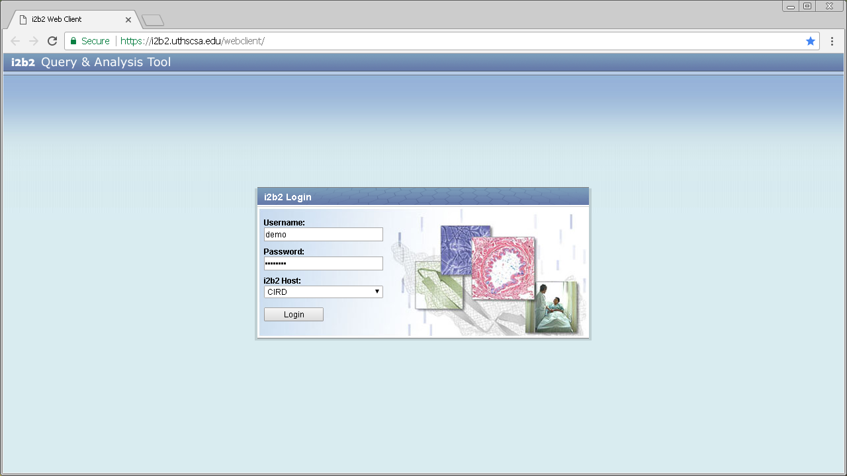
The URL for the UTHSCSA I2B2 installation
Input your provided username in this field
Input your password in this field
Leave this field alone
Click this button to log in
If you forget your password email your username to informatics@uthscsa.edu and tell them you need to rest your I2B2 password.
If you wish to sign up for a new I2B2 account use: *when prepared there will be a link on the screen*

Slide 4
How to find terms and concepts
Back to Table of Contents

Slide 5
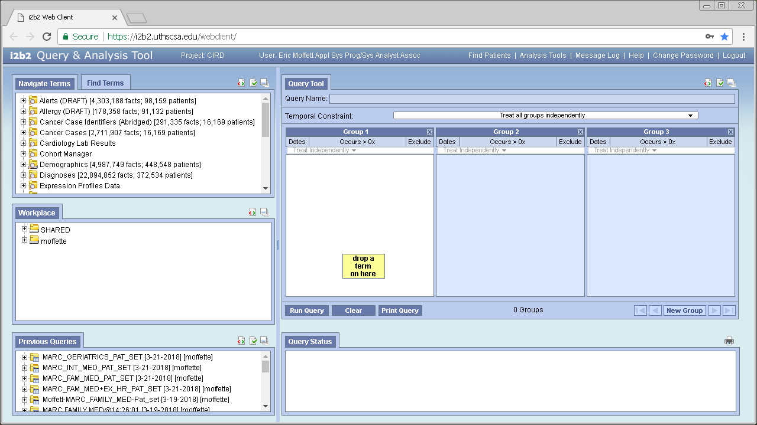
In this tab you’ll find concepts/terms for your query in a hierarchical structure

Slide 6
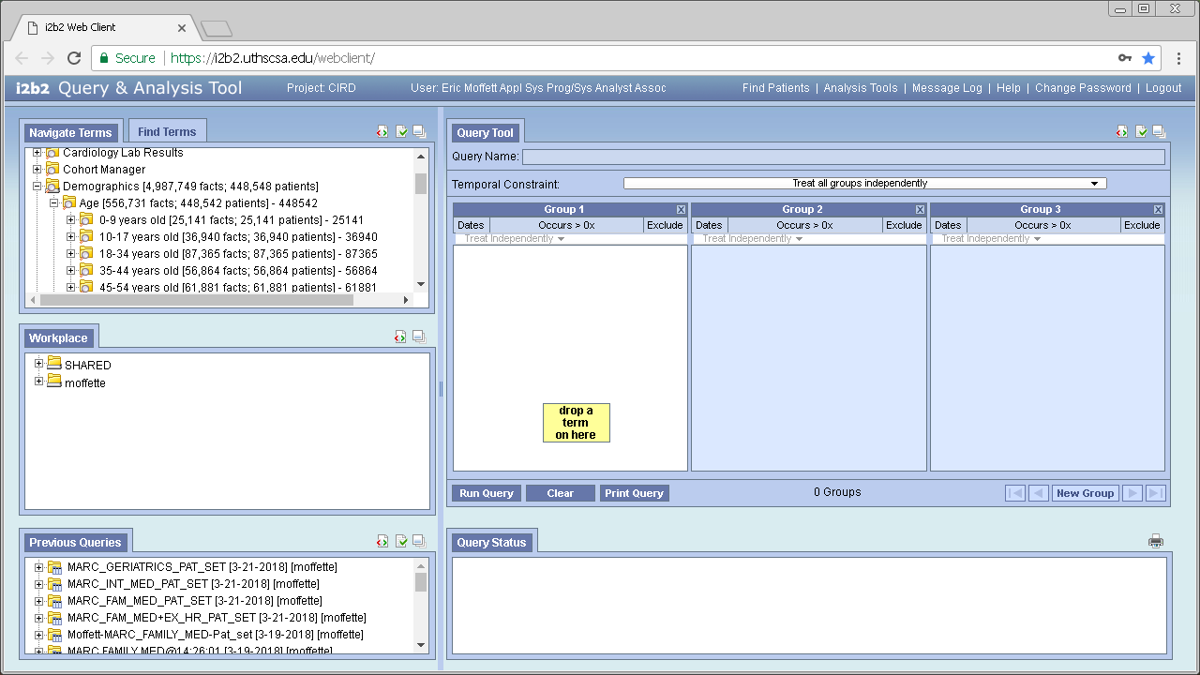
You can expand folders by clicking +
and close them by clicking -

Slide 7
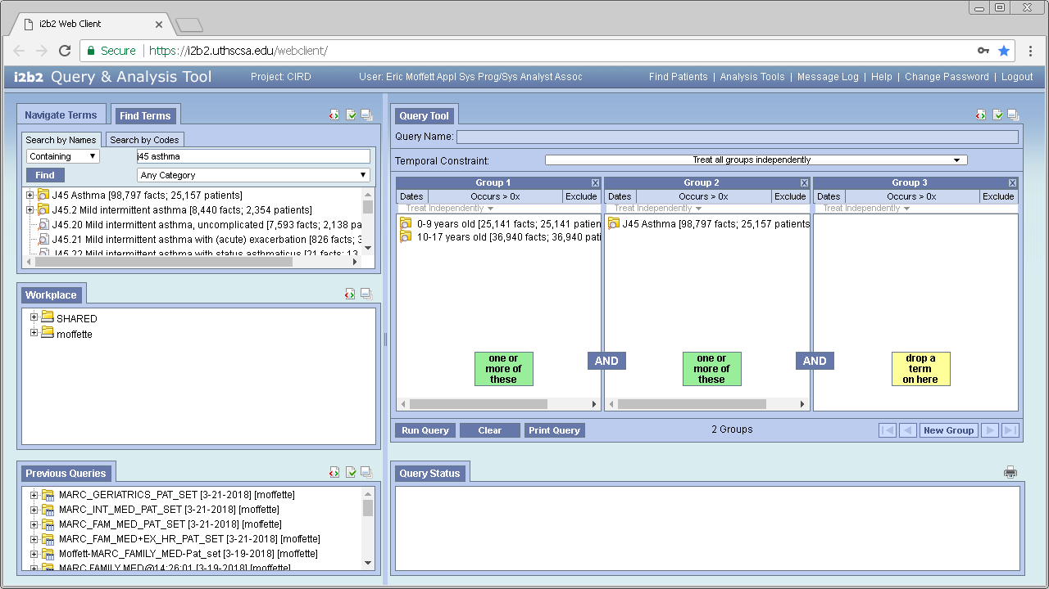
‘Find Terms’ allows you to search for a term

Slide 8
Type in what you want to search for here

Slide 9
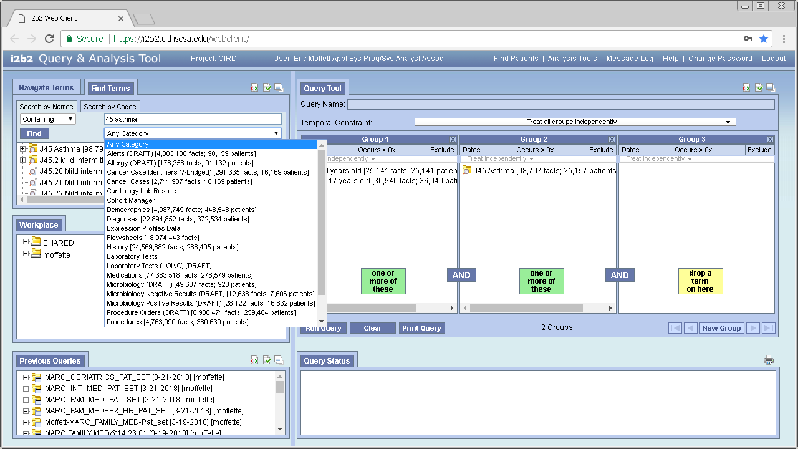
Selecting a category will decrease search times and reduce extraneous results

Slide 10
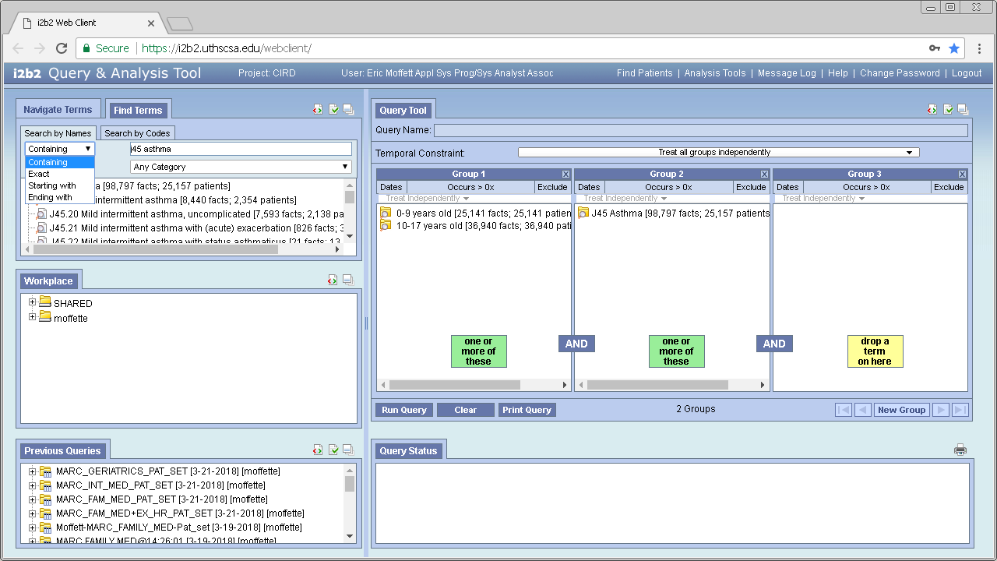
You can change the search criteria with this drop down

Slide 11
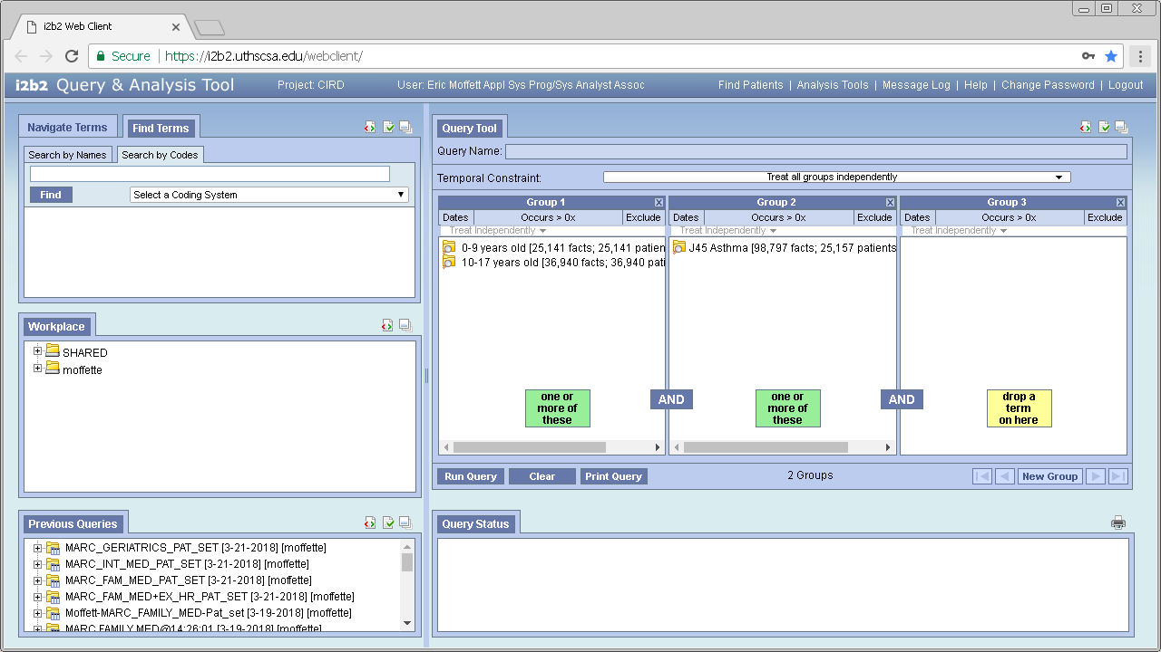
You can search by codes by clicking this tab

Slide 12
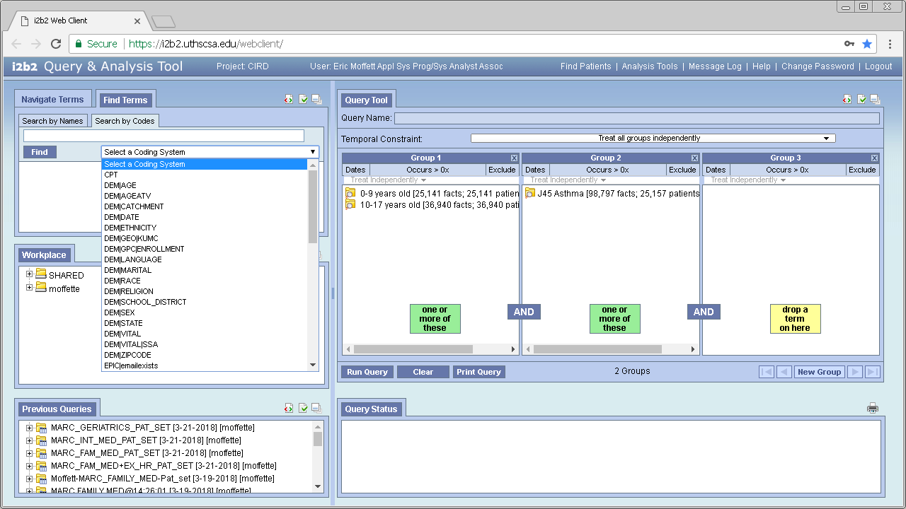
Select the coding system of the code you’re going to search by from this drop down

Slide 13
Building your query
Back to Table of Contents

Slide 14
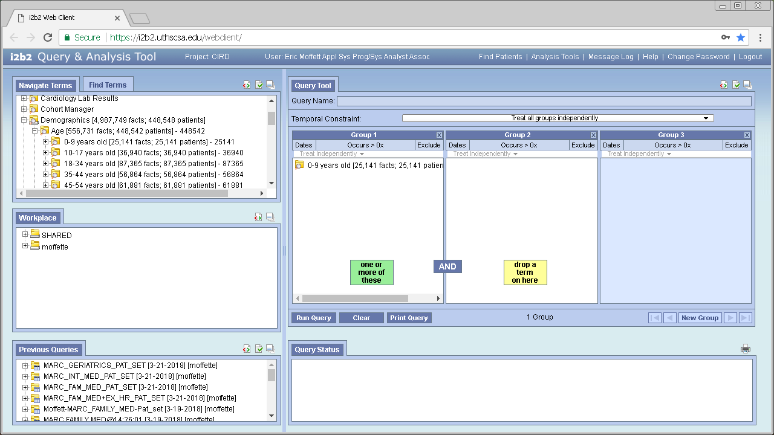
You can drag and drop to add terms/concepts into the group boxes

Slide 15
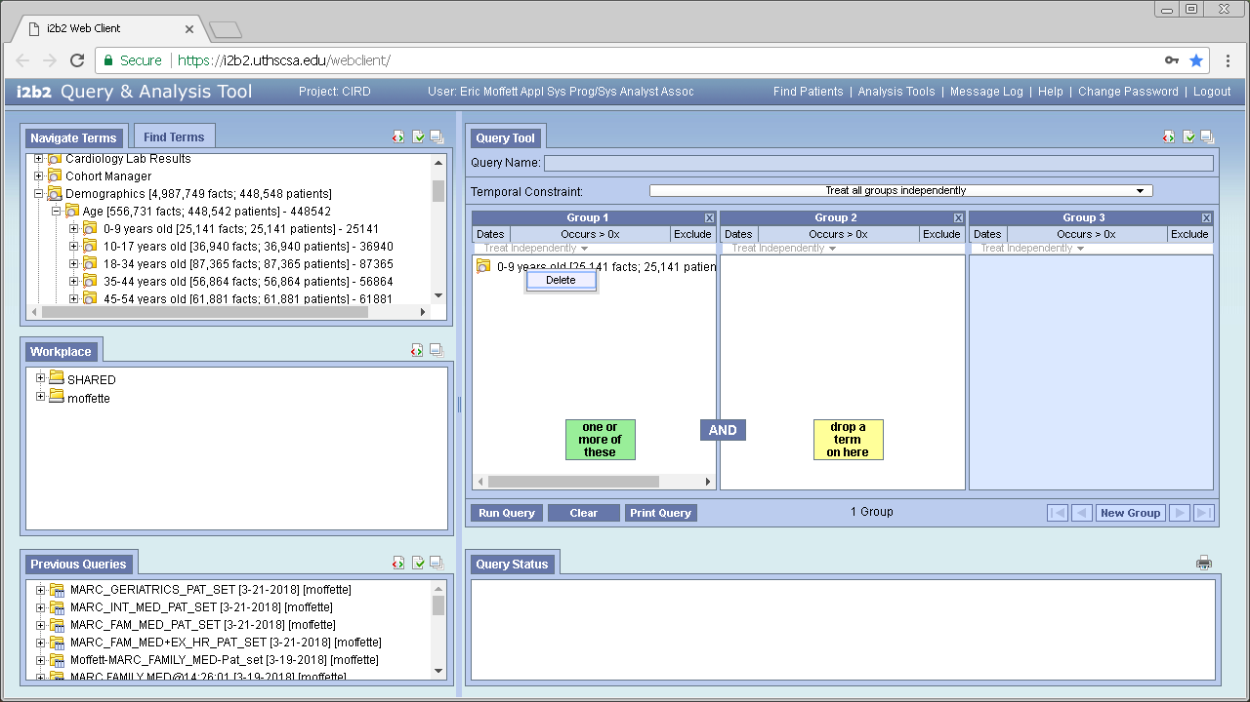
Right-click a term/concept and click ‘Delete’ to remove it

Slide 16
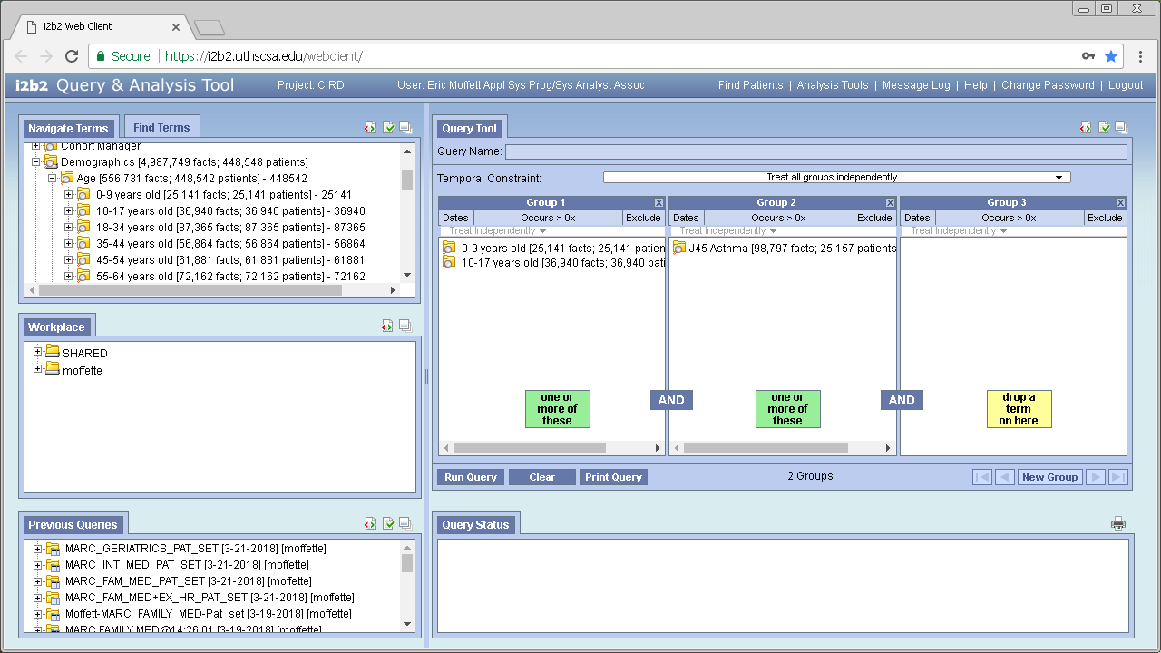
For example “A or B” is true if:
‘A’ is true and ‘B’ is false
‘B’ is true and ‘A’ is false
both ‘A’ and B are true
Within a column is a logical ‘OR’
‘0-9 years old’ OR ‘10-17 years old’

Slide 17
For example “A and B” is true only if both A and B are true
Between columns is a logical ‘AND’
(‘0-9 years old’ OR ‘10-17 years old’) AND diagnosed with ‘J45 Asthma’

Slide 18
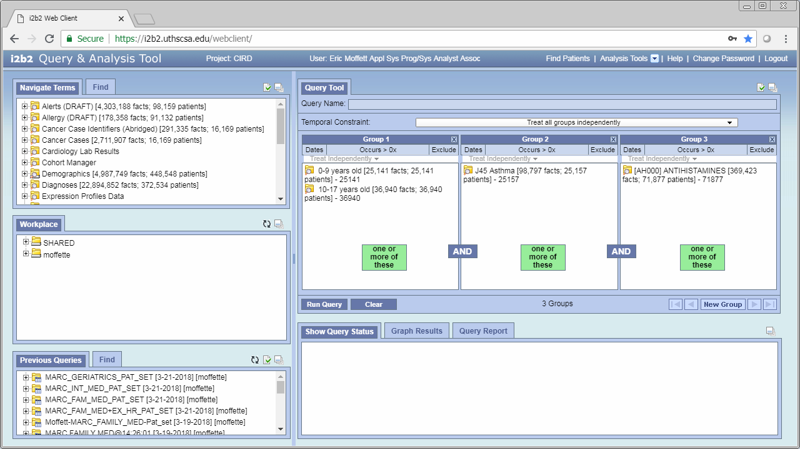
Click ‘New Group’ to add an additional group and use the arrows to navigate the groups

Slide 19
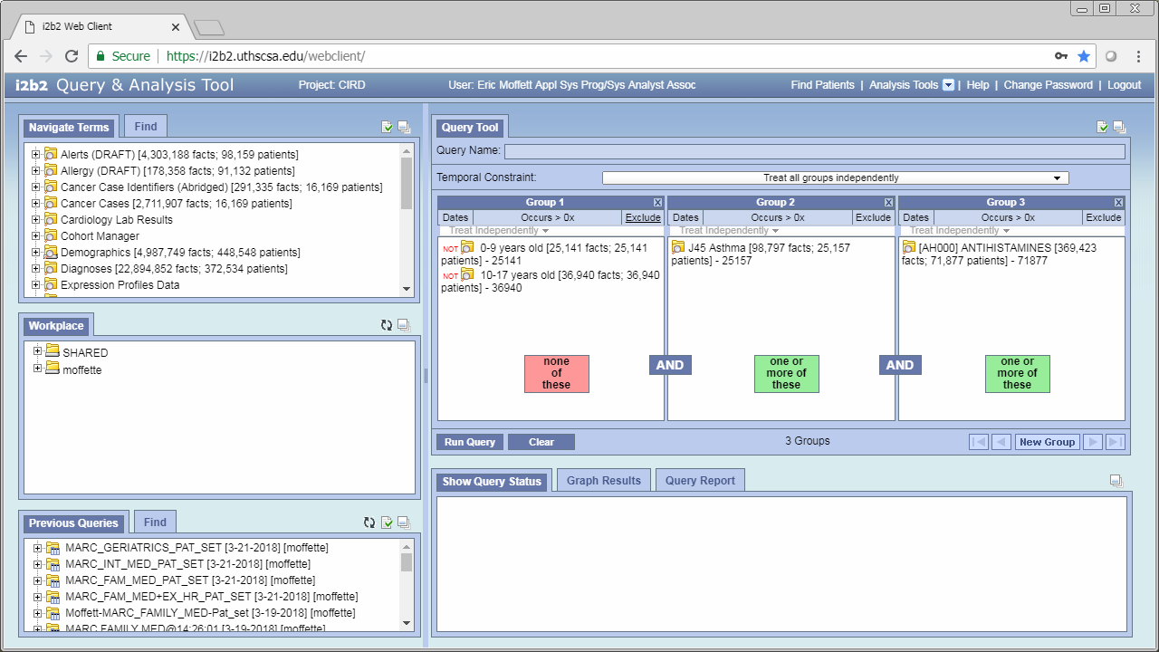
Click here to exclude the group
‘one or more of these’ will become ‘none of these’

Slide 20
Click here to constrain the group to a specific date range

Slide 21
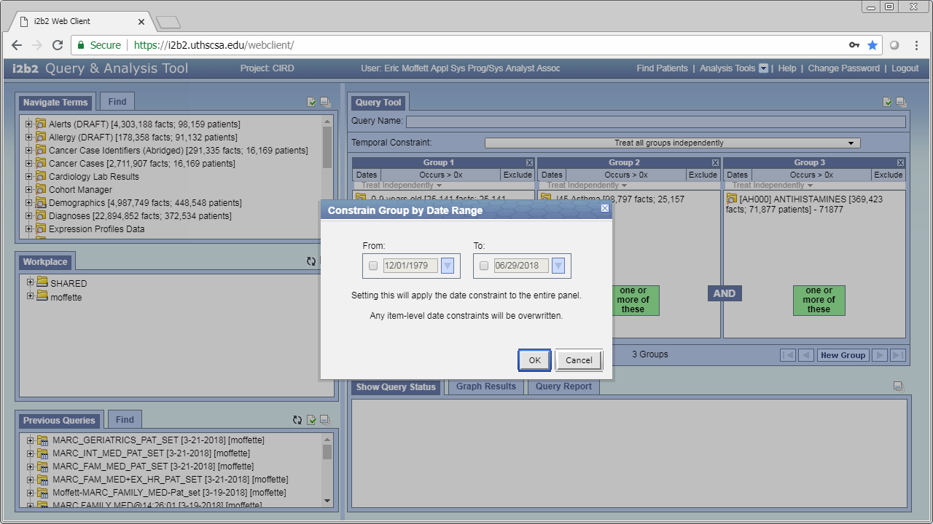
Check the checkbox and select a From and/or To date to restrict the date range of concepts in this panel.

Slide 22
Click here to constrain the group to by a number of occurrences

Slide 23
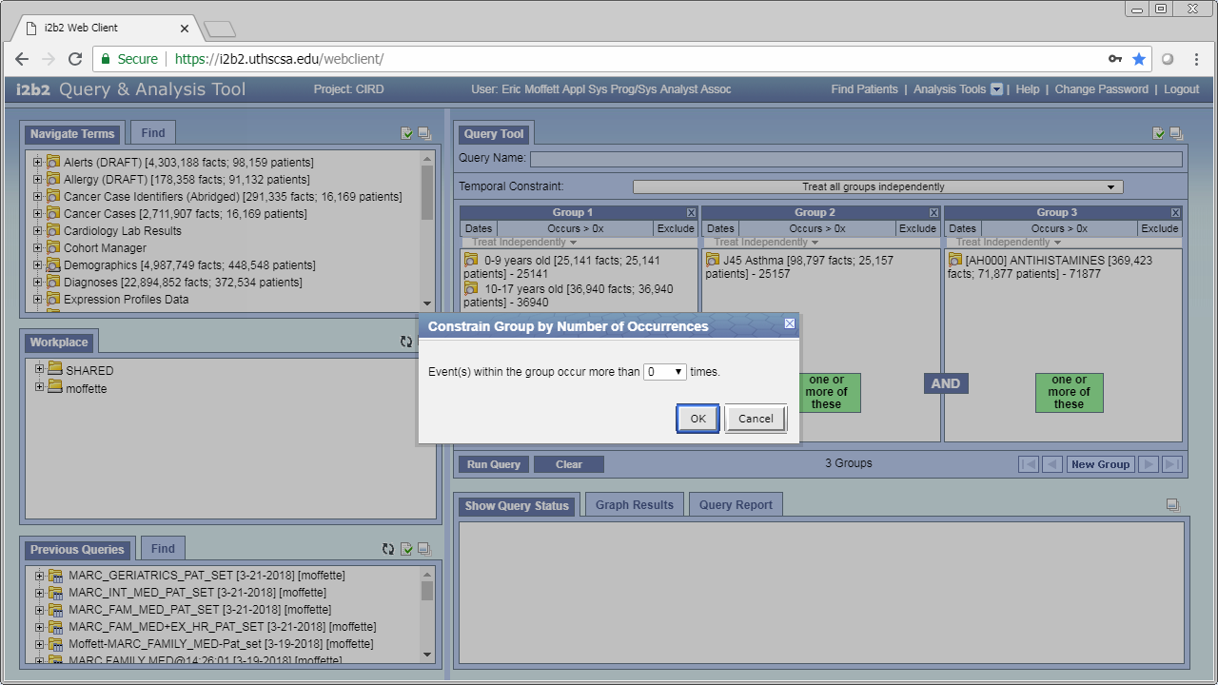
Use this drop down to select the number of occurrences, and then click ‘Ok’ to confirm or ‘Cancel’ to discard the changes.

Slide 24
‘Clear’ will clear everything from all groups

Slide 25
Running your query
Back to Table of Contents

Slide 26
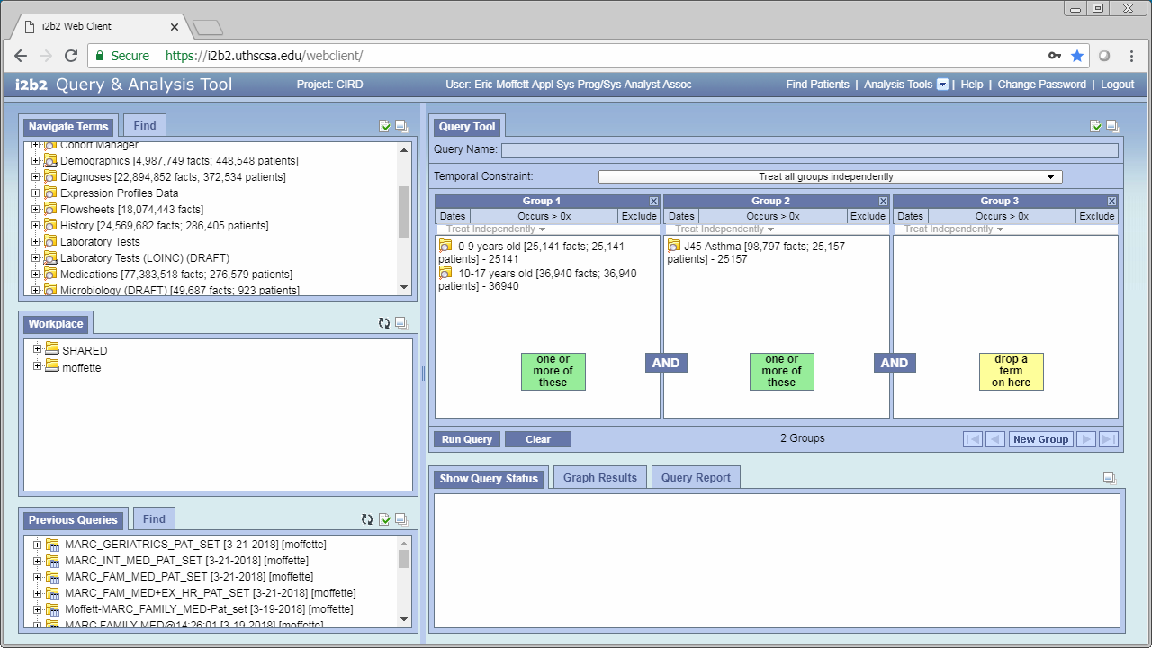
Click here to run your query

Slide 27
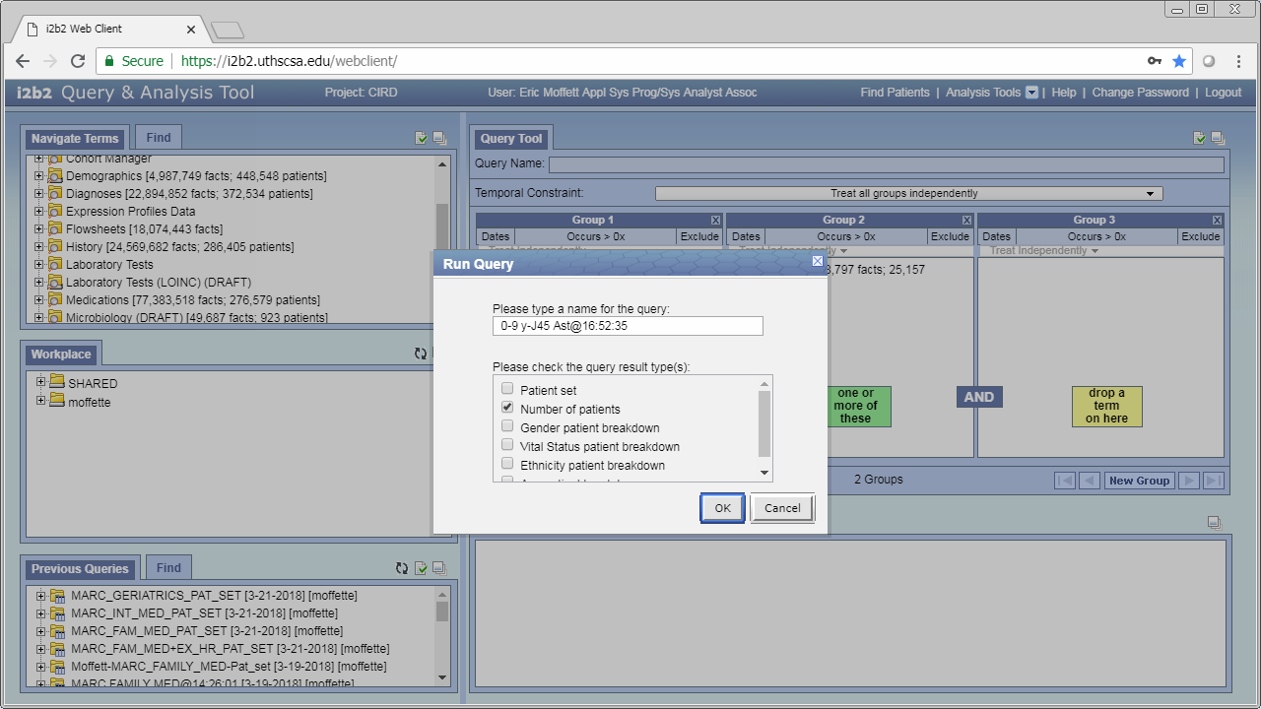
A name for your query based on the criteria you selected will be generated but you can name your query with this box
Check this box to get a patient set which is necessary for most analysis tools
Check this box to get a count of the patients that fit the criteria of your query
Check this box to get a demographic breakdown of the patients by gender in the query report

Slide 28
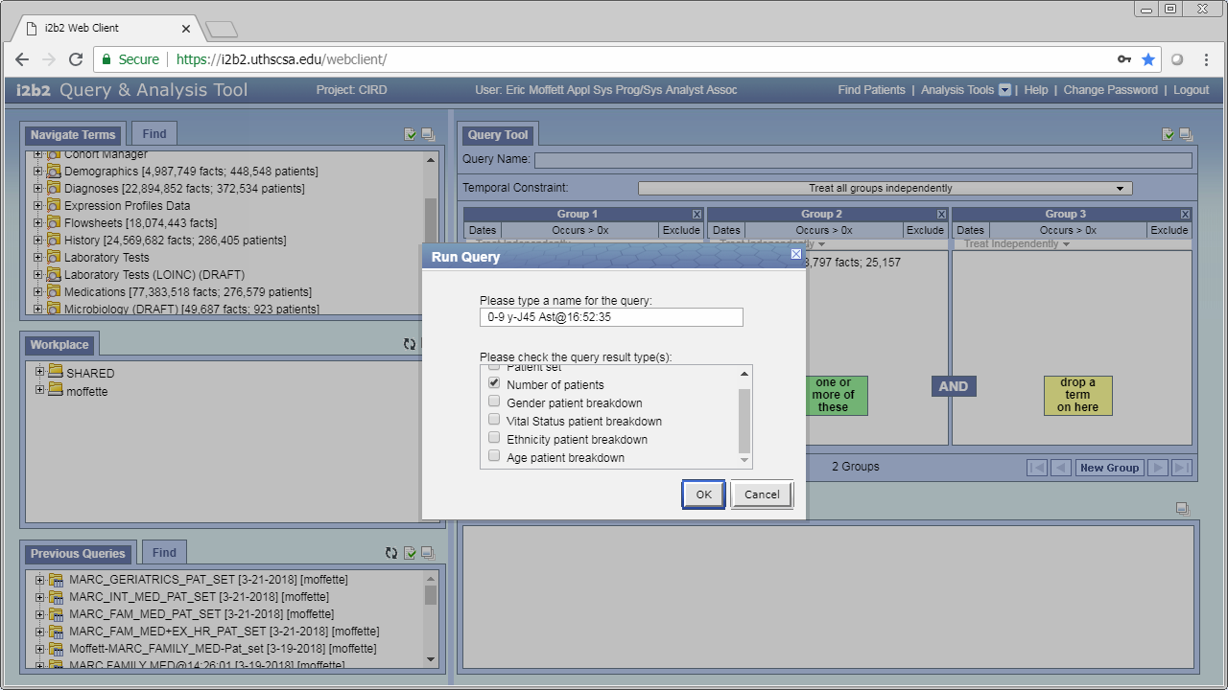
Check this box to get a demographic breakdown of the patients by their vital status in the query report
Check this box to get a demographic breakdown of the patients by ethnicity in the query report
Check this box to get a demographic breakdown of the patients by their age in the query report
Click ‘OK’ to run the query, and ‘Cancel’ to clear the changes and close the pop up.

Slide 29
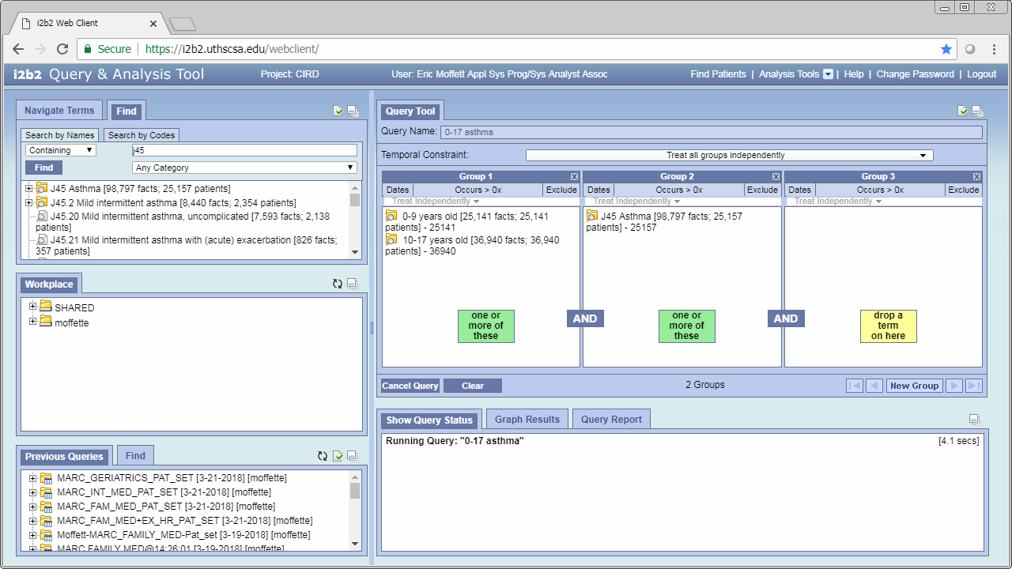
This tab shows the status of your query
This shows how long your query has been running for.
This is the actual status of the query

Slide 30
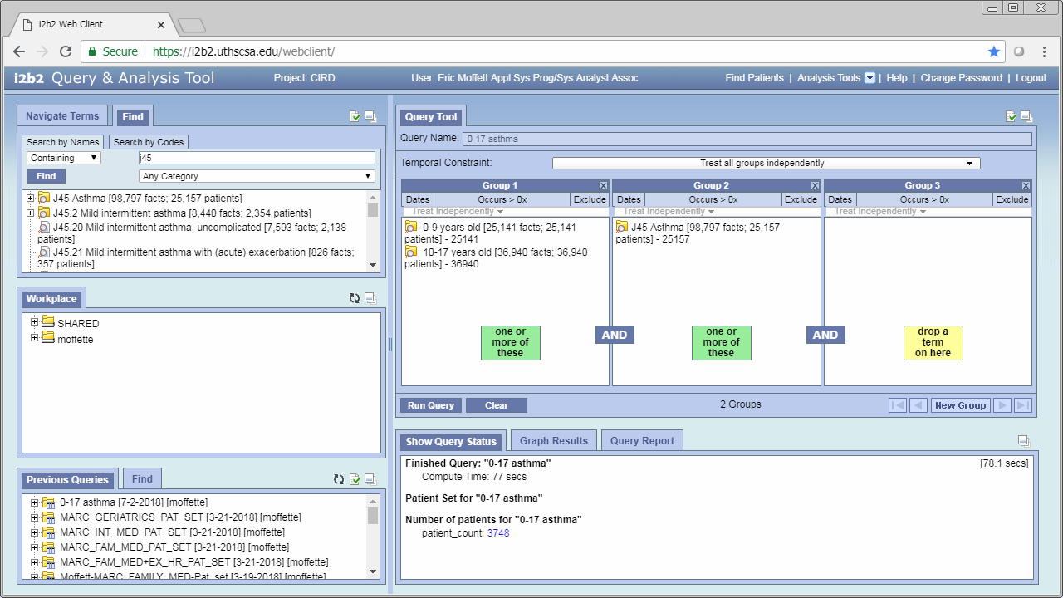
When your query finishes you’ll see something like this

Slide 31
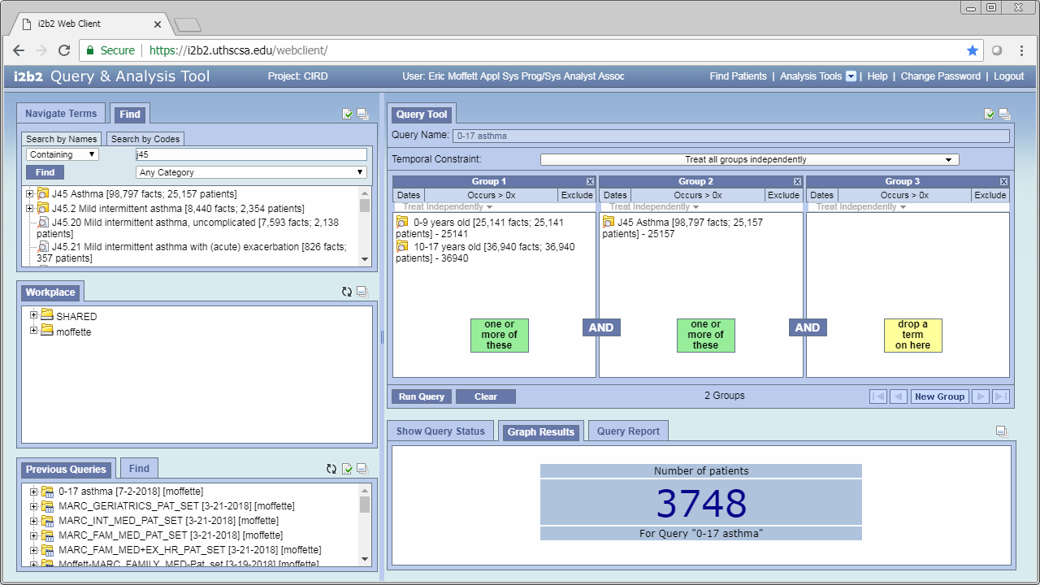
If you have any demographic breakdowns checked a graph will be generated here

Slide 32
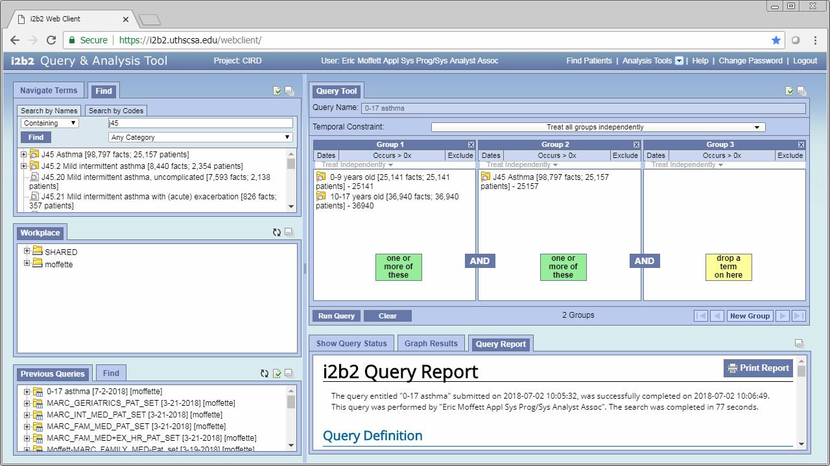
This gives you your query report which contains more detailed information including more information if you requested demographic break downs

Slide 33
Accessing your previous queries
Back to Table of Contents

Slide 34
Your previous queries will be shown here

Slide 35
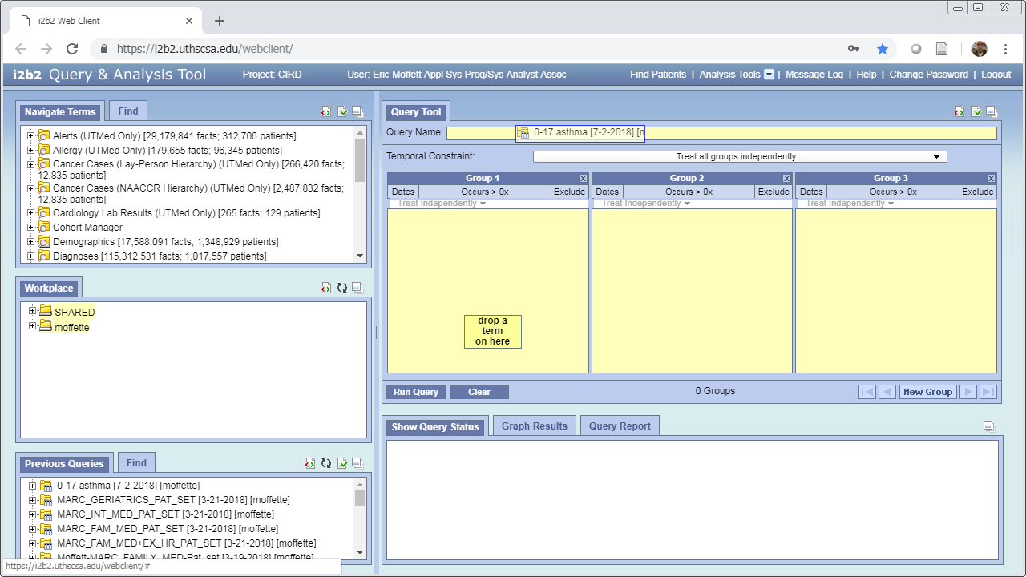
You can have a previous query rebuilt by dragging and dropping it into the “Query Name” box

Slide 36
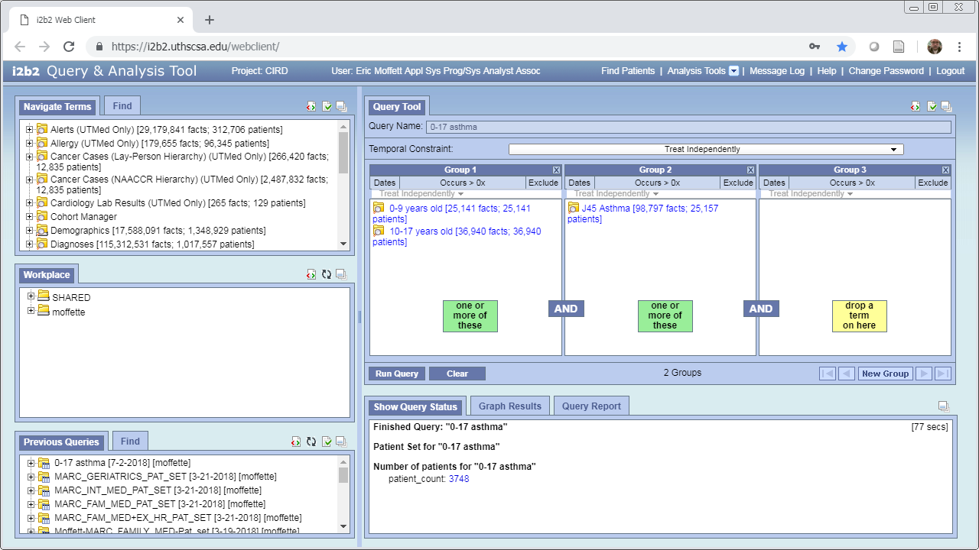
You can rerun the previous query to see if the results change after data refreshes, or view the previous results as well

Slide 37
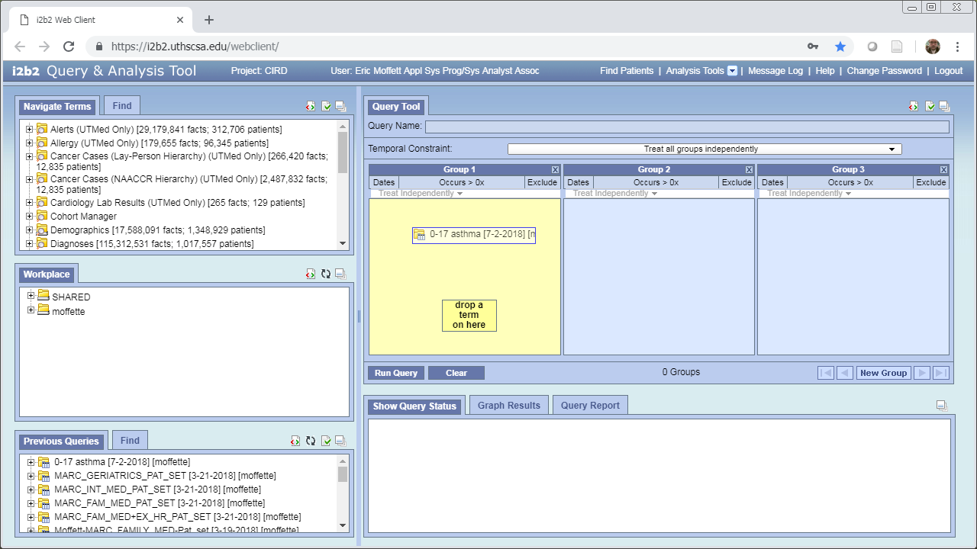
You can have a previous query used as inclusion or exclusionary criteria by dragging it into a group and toggling the ‘Exclude Include’ button. The previous query can be by itself or with other criteria in the group

Slide 38
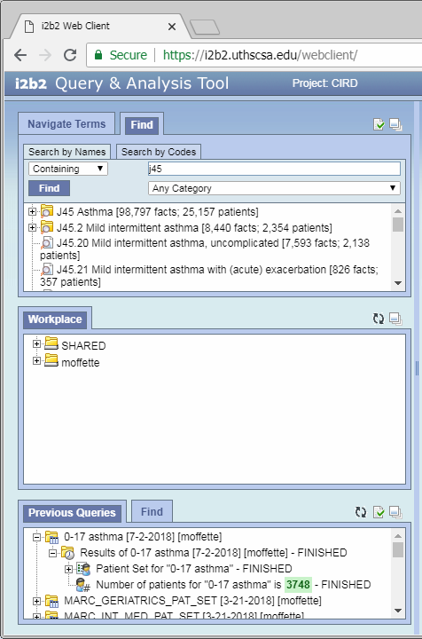
You can access your previous patient sets by expanding a previous query as well

Slide 39
Using Plugins
Back to Table of Contents

Slide 40
Clicking the drop down icon next to ‘Analysis Tools’ will provide you with the list of available analysis tools

Slide 41
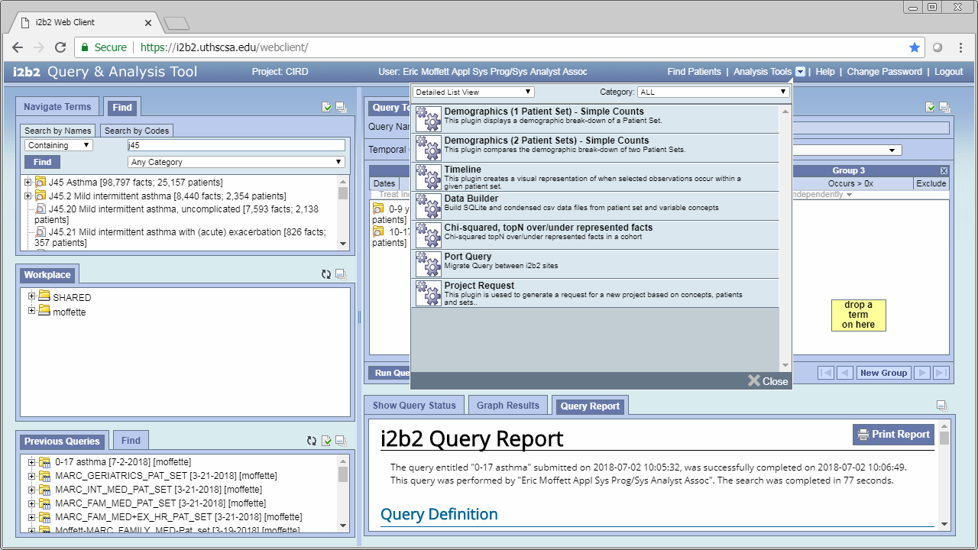
Note: Depending on your user permissions you will have a different selection of plugins available.
These are the analysis tools that can be used to do various analysis on your patient set

Slide 42
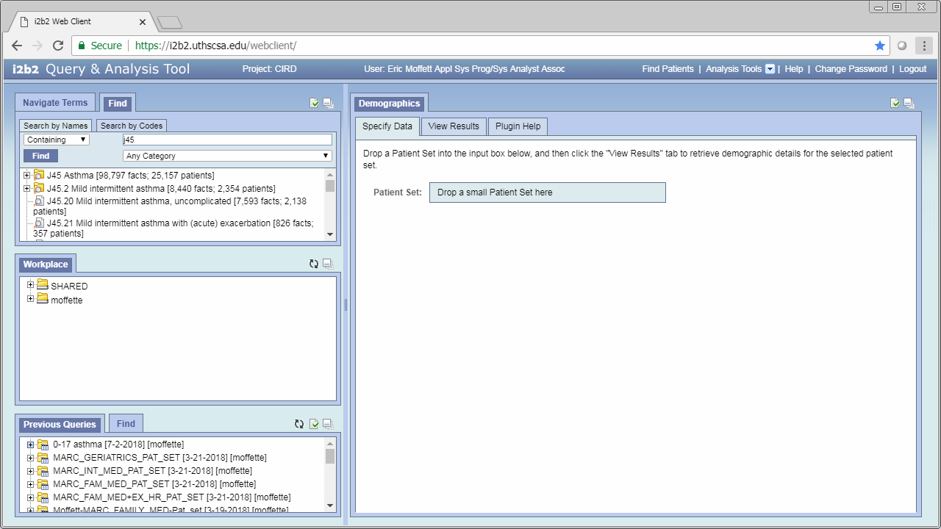
You can drag and drop your patient set from the previous query box

Slide 43

This tab gives you the results of your patient set analysis

Slide 44
Temporal Constraints
Back to Table of Contents

Slide 45
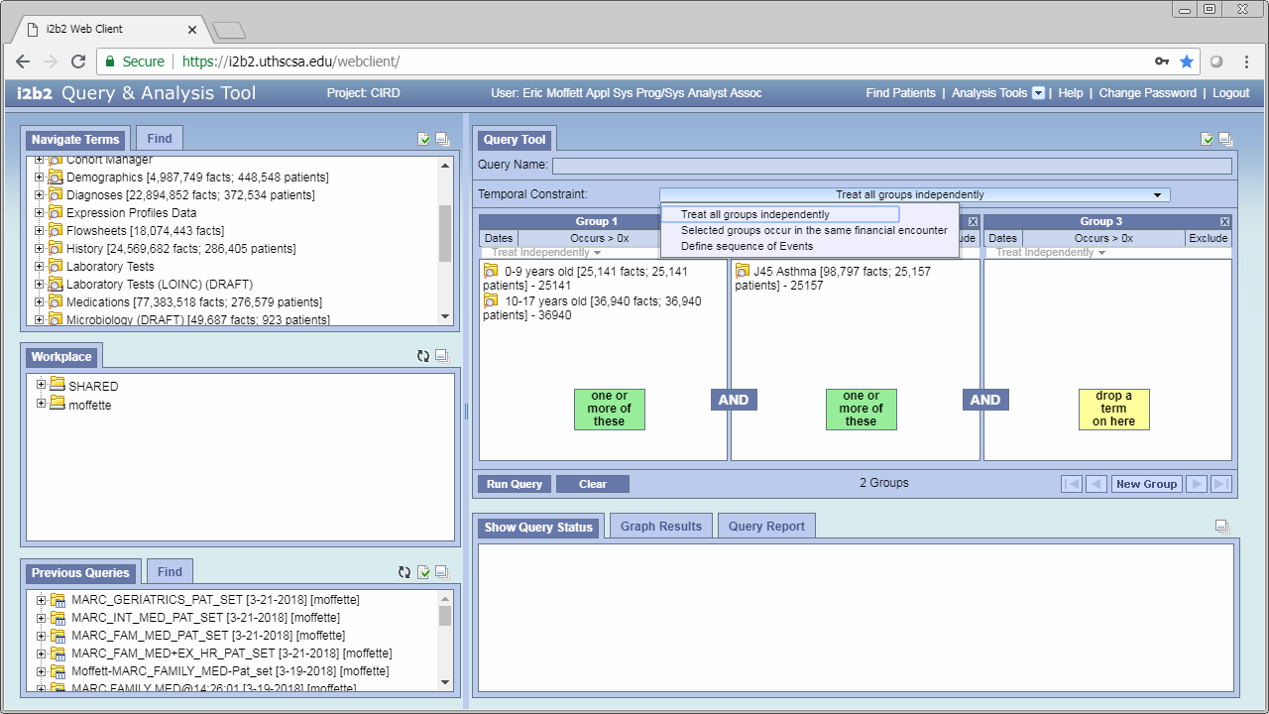
Temporal Constraints may lead to greatly increased run times but allow for more complex queries

Slide 46
Treat Independently: Use this for most queries when you care that something happened, but don’t care how they happened in relation to the other selected events
Selected groups occur in the same financial encounter:
Select groups which happened during the same visit/encounter. E.g. you only want a certain diagnosis if it happened at the same time as a lab result or procedure.
Define sequence of Events: Use to define the order of events.

Slide 47
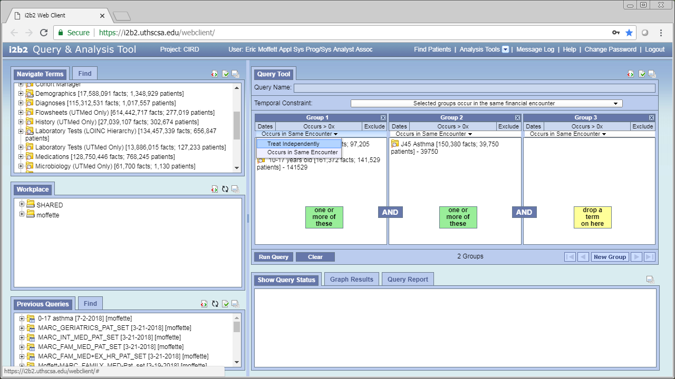
Treat Independently: Use this for things like Age, Sex, and other demographic variables, or when you don’t care if they happened in the same encounter.
Occurs in the same encounter:
These events happened during the same visit/encounter.

Slide 48
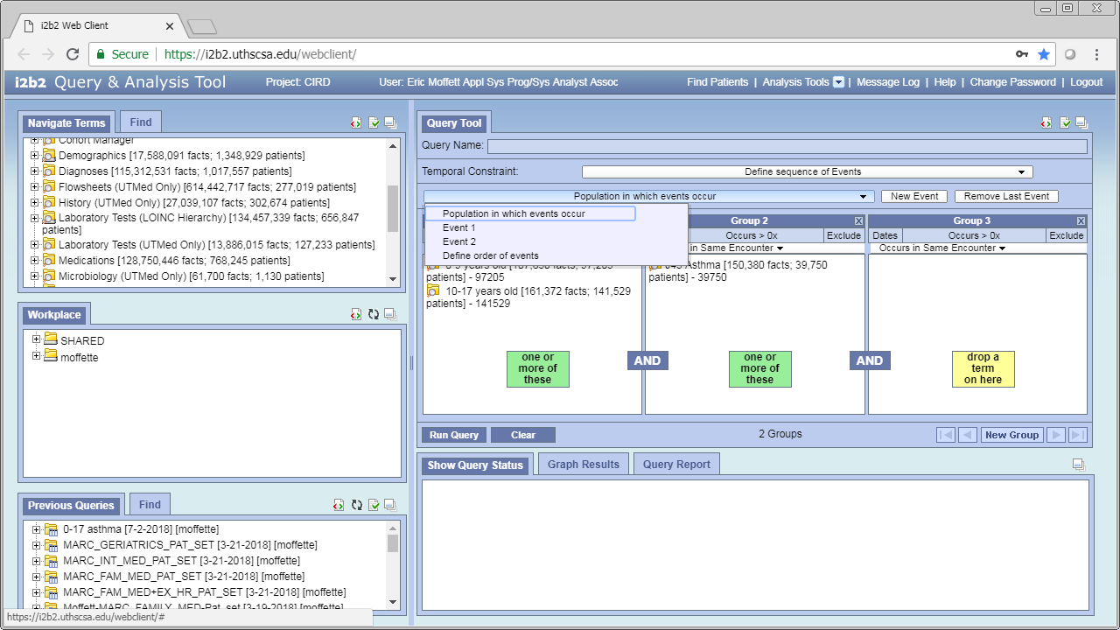
When defining a sequence of events you will need to fill out at least 4 panels:
Population in which events occur:
Use this to indicate the population as opposed to chronological events. E.g. asthmatics between the ages of 0 and 17.

Slide 49
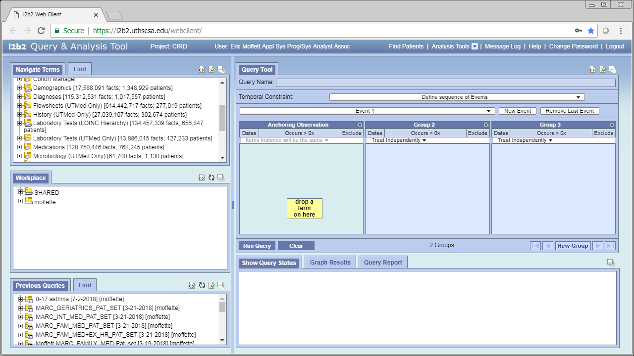
Event X:
Use these panes to define a chronological event.

Slide 50
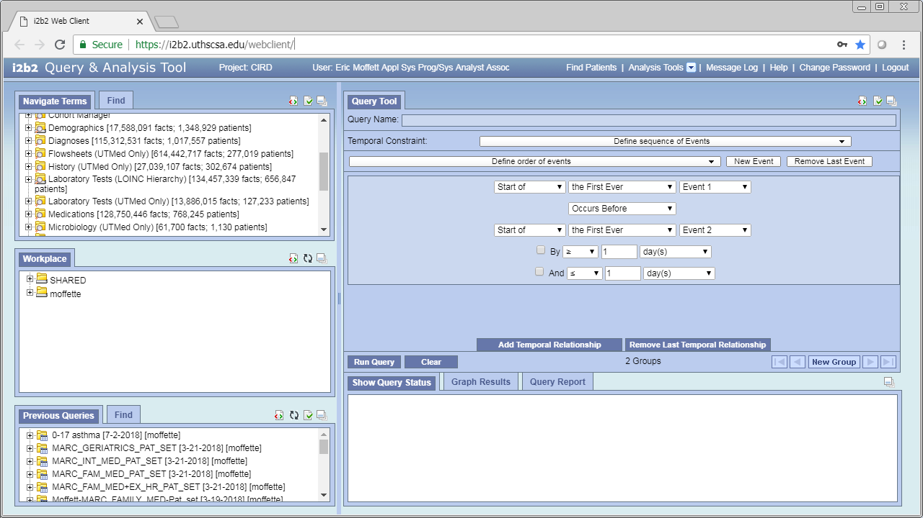
Define order of events:
Use this panel to define the order of events.

Slide 51
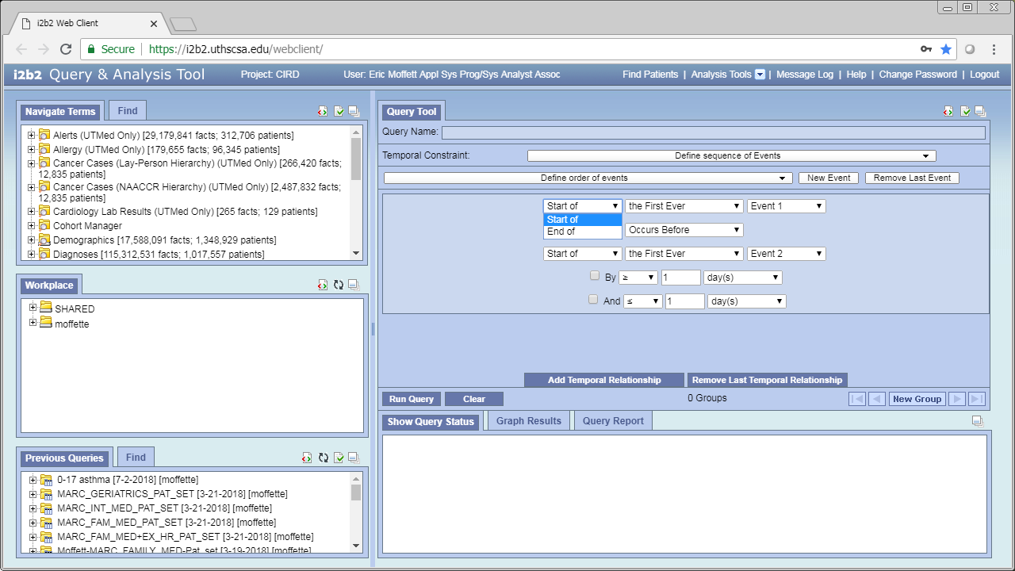
Define order of events:
The “start” or “end” of an event.
Most events are “instantaneous” or their start and end dates are the same.
Some events, such as a problems list diagnosis may be long term. E.g. problems list diabetes may span many years while the procedure “ultrasound” or a billed diagnosis of “diabetes” would be instantaneous.

Slide 52
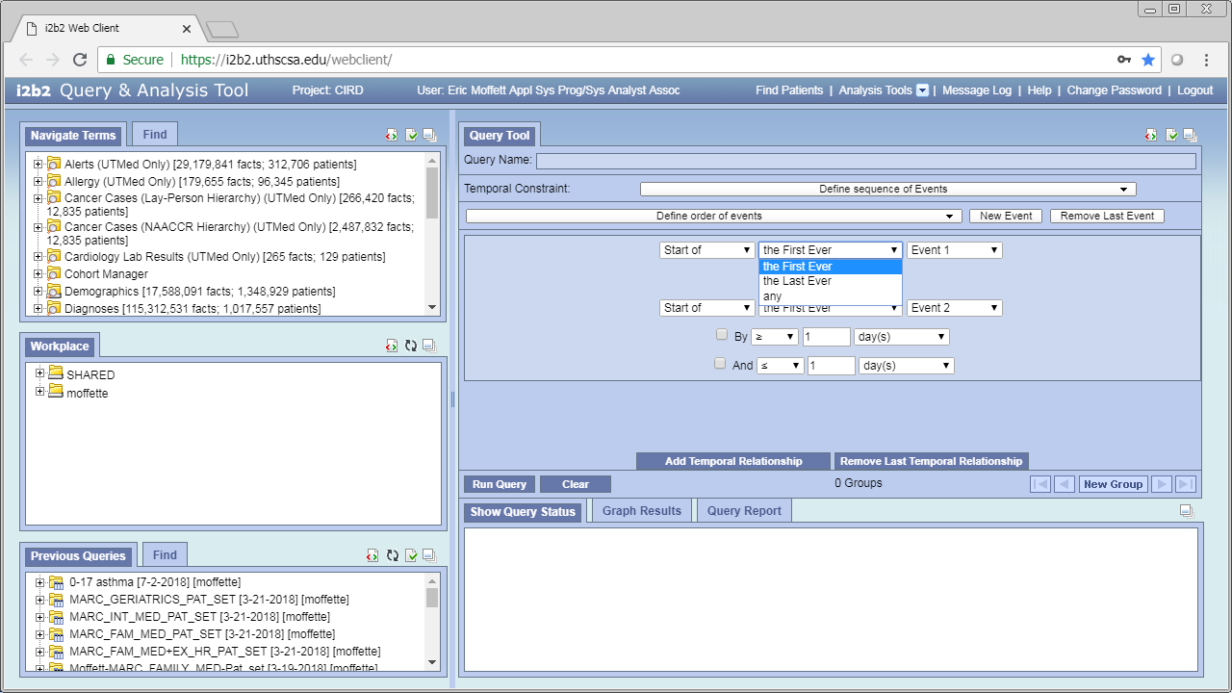
First instance of the event, last instance of the event, or any instance of the event.
Note: the “first” instance of an event does not mean the first diagnosis of an event, only the first time it was captured and extracted from the system.
Note: the “last” instance of an event does not mean that a diagnosis was “cured” at the time of the last event. E.g. a last instance of diagnosis of diabetes does not indicate that the patient no longer had diabetes.

Slide 53
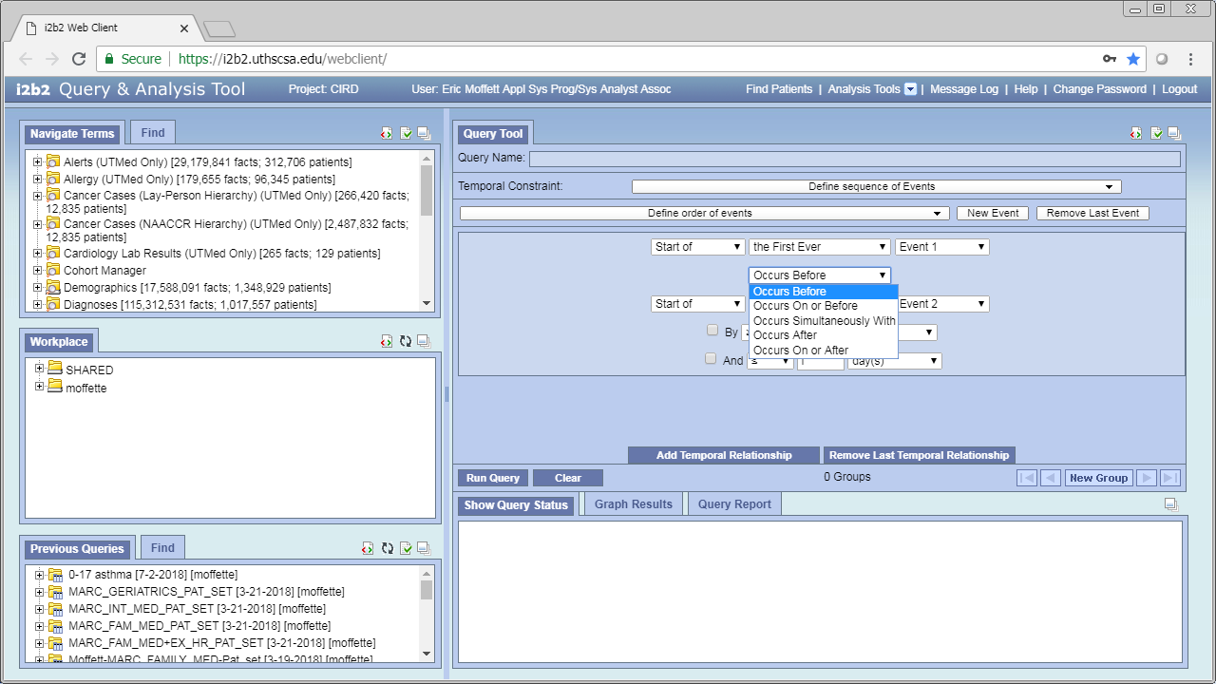
Indicate the temporal constraint you wish to apply.

Slide 54
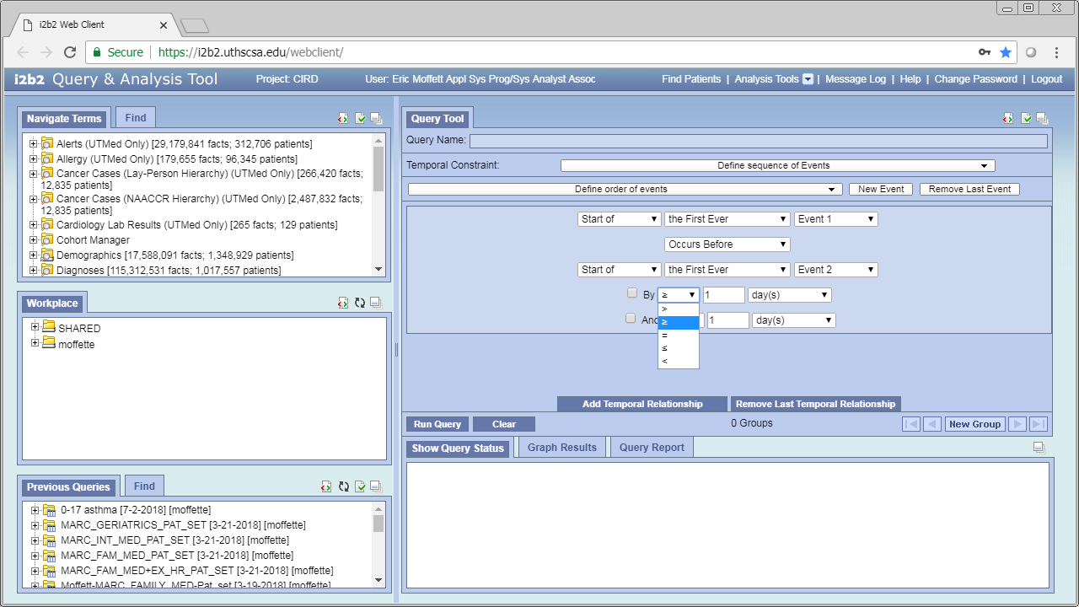

Optionally you can add an additional constraint of it happening within a certain number of hours, days, months, or years.
Run the query the same way you run a normal query.

