Slide 1
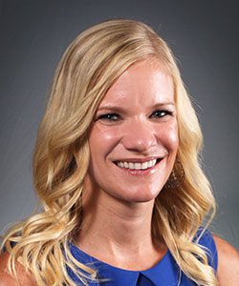
DEPARTMENT OF PHARMACOLOGY
SEMINAR SERIES
Mediator Subunit 12 acts as a Tumor Suppressor by Restricting GL13-dependent SHH Signaling
presented by
Marieke Burleson, Ph.D.
Assistant Professor
Department of Biology
University of the Incarnate Word
San Antonio, Texas
Wednesday, February 1, 2023
12:00pm – 444B - LSOM
For more information contact Ann Miller (millera5@uthscsa.edu)
For information, contact Ann W. Miller @ millera5@uthscsa.edu

